Slide 1
A Family History of Broadcasting in Minnesota and Wisconsin
By Mark W. Persons
An Engineer’s Story

Slide 2
An autobiography by Charles B. "Charlie" Persons(89) 1909 to 1998

Slide 3
WEBC Superior, WI 50 Watt Transmitter in 1926

Slide 4
The WEBC Orchestra 1935

Slide 5
The WEBC Control Room in 1935

Slide 7
The WEBC Transmitter in 1935

Slide 8
The WEBC Transmitter 1935

Slide 9
Field Intensity Measuring in 1937

Slide 10
The WMFG, Hibbing, MN Androy Hotel in 1938

Slide 11
The WEBC Transmitter, late 1940s

Slide 12
Stations built along the way for the Arrowhead Network include:
WEBC Duluth, the Flagship Station
WMFG AM, Hibbing, MN
WEVE AM, Eveleth, MN
WHMS AM, Hayward, WI
WEAU AM, FM & TV in Eau Claire, WI
WISC AM, FM in Madison, WI

Slide 13
WELY in Ely, MN, 1000 W, 1450 KHz Built in 1954, this photo is from 1990s

Slide 15
U.S. Army, Ft. Monmouth, NJ

Slide 16
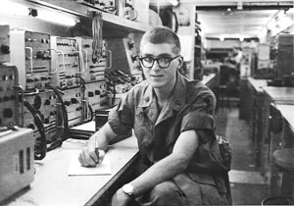
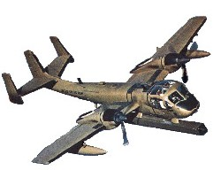
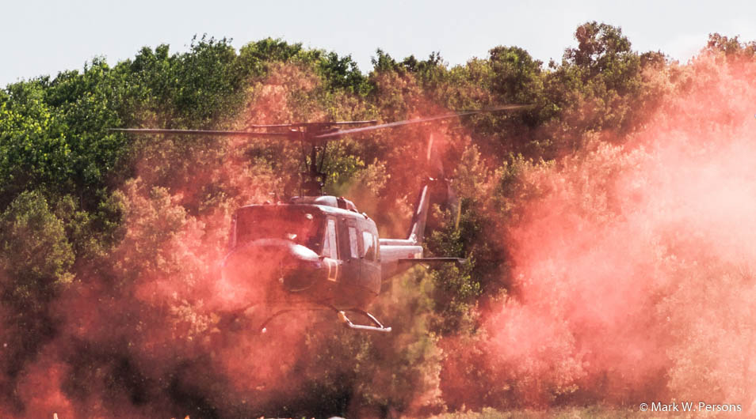
U.S. Army Sergeant Vietnam 1968-69

Slide 17
4th and Laurel Streets

Slide 18
KVBR in Brainerd, MN. 1970s 1000 watts on 1340 KHz

Slide 19
Charlie Persons “The Flying Broadcaster”in the 1970s 161.64 MHz

Slide 20
1992 photo at KVBR Radio in Brainerd, MN June Persons (97) 1916 to 2013 Charlie Persons (89) 1909 to 1998

Slide 21
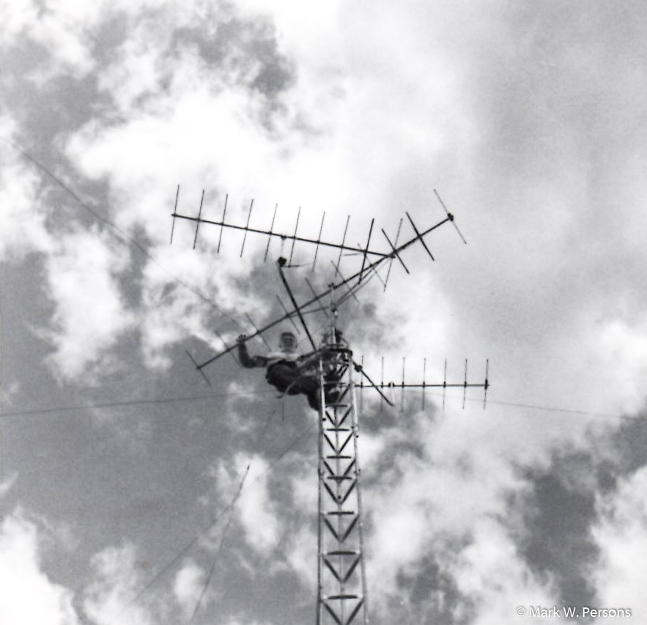
Broadcast engineers don’t climb towers!

Slide 22
Antenna coupling network, KLOH-AM, Pipestone, MN. 9 KW day/430 W night.

Slide 23
GMC all-wheel drive van, not a pickup!

Slide 24
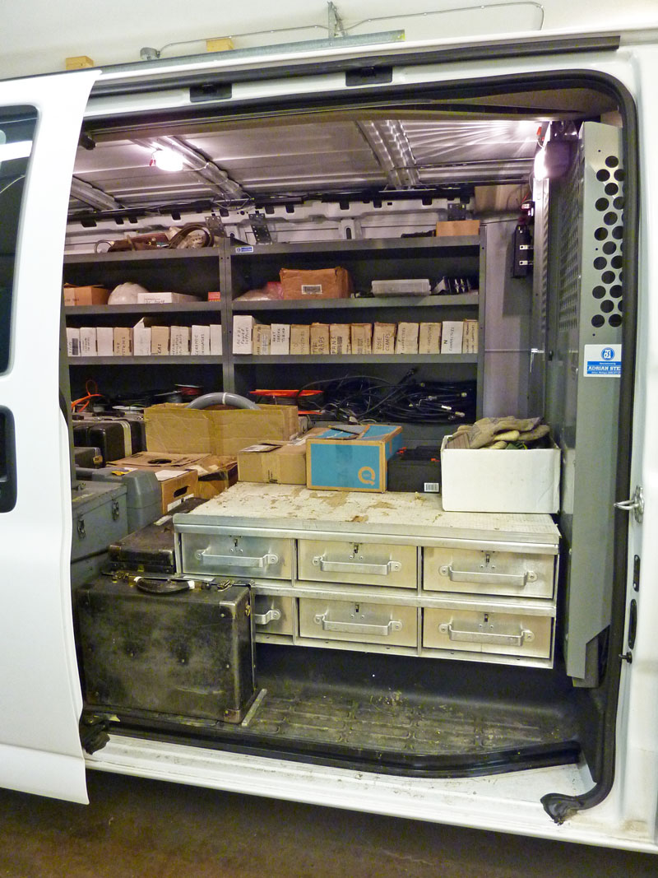
$75,000 in tools and parts

Slide 25
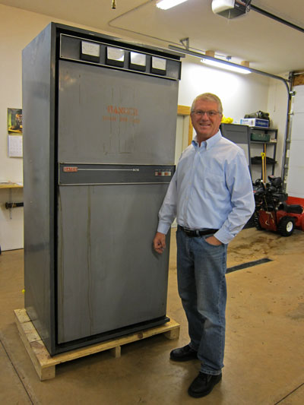
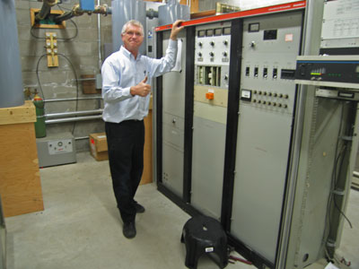
So many transmitters, so little time.

Slide 26
WJJY and B93.3 Transmitters

Slide 27
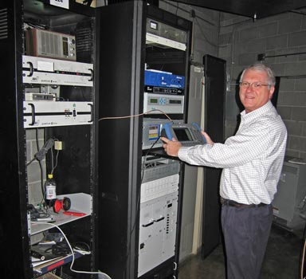
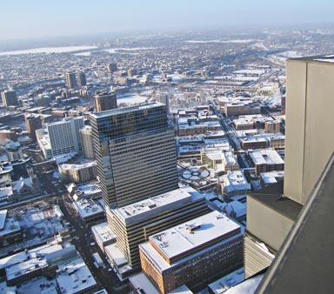
IDS Building Minneapolis

Slide 28
WKKQ-AM, Hibbing, MN. 10 KW, 5 Tower
WTBX-FM, Hibbing, MN. 100 KW
KJJK-AM, Fergus Falls, MN. 1 KW, 2 tower
WDCQ-AM, Ft Meyers, FL. 10 KW, 3 tower
KPUP-AM, Monterey, CA. 10 KW, 3 tower
KULO-FM, Alexandria, MN. 25 KW
KBLB-FM, Nisswa/Brainerd, MN. 100 KW
KKCQ-FM, Fosston, MN. 50 KW
KKEQ-FM, Bagley/Fosston, MN. 25 KW
KKZY-FM, Bemidji, MN. 100 KW
KBHP, Bemidji, MN. 100 KW
KBUN-FM, Blackduck/Bemidji, MN. 8.5 KW

Slide 29
Hubbard Radio Brainerd WJJY/KBLB/KUAL/KLIZ/KVBR

Slide 30
Ken and Tess on WJJY Radio

Slide 31
Engineering Room at Hubbard

Slide 32
Residence & Office on Gilbert Lake

Slide 33
M.W. Persons Office

Slide 34
M.W. Persons Service Shop

Slide 35
M.W. Persons Service Shop

Slide 36
We shop local and buy American

Slide 37
SBE Award Ceremony in Boston, MA, October 3, 2018.

Slide 38
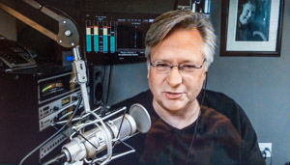
Where Have All The Broadcasters Gone? Available free as an audio book, narrated by Kirk Harnack http://mwpersons.com/old-radio/books/index.html

